Slide 2
A SAFE WORKPLACE
John Dougan, ARM, ALCM
Sr. Risk Control Specialist
Notes:
There is no doubt that everyone desires to provide a safe work environment for employees and volunteers. This presentation looks at safety elements required by CAL OSHA that sometimes need additional attention based on observations made during risk control surveys and loss statistics.
This presentation will also reflect and/or be affected by observations made during the walkthrough of the facility.

Slide 3






Standards Awareness
CAL OSHA
National Fire Protection Association (NPA), California Fire Code, etc.
EPA
Health Codes
Notes:
We do not have enough time to describe the applicable aspects of each of the various codes and standards, but the reasons for these standards and others is obvious: protect workers, visitors, volunteers and students, among others. Property protection will also benefit.
To ensure an adequate level of protection, however, we need to ensure that we increase our knowledge of codes and standards applicable to our operations. Much is available on line and in some cases, like with CAL OSHA, some information is available in a simplified etool format. We can also try to periodically attend workshops or learn from online webinars.

Slide 4

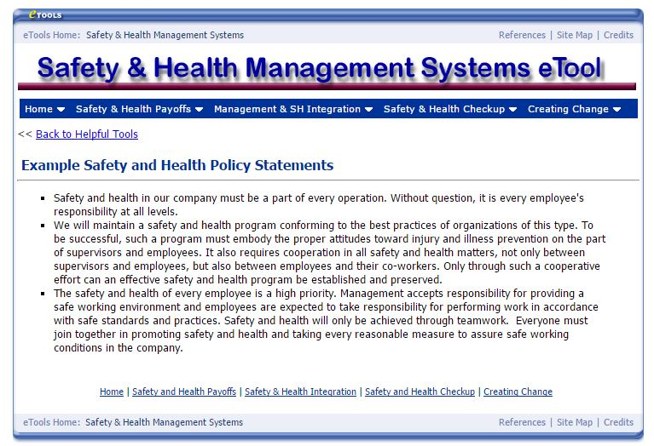
Program Basics
Safety Policy
Job descriptions
Job hazard identification
Job training (documented)
  Orientation
  Job specific
Personal Protective Equipment (PPE)
Notes:
While much of the following is an administrative function, it is addressed here as an overview of some important elements of the school safety program.
All employees need to understand the school’s commitment to safety and what the administration and supervisors expect from employees as regards safe work practices. Safety policies do that and need only be no more than a brief statement in the employee handbook.
Job descriptions establish each employee’s responsibilities, which in turn, helps to define the hazards that might be encountered and what training and safety equipment will be required.
Training generally comes in two forms: General Orientation training, which is the training all employees receive and might include fire and life safety, lifting/material handling, and others that impact all employees. Job Specific training addresses such things as the use of machines or grounds equipment, chemicals, vehicle use, and others, as applicable to an individual’s responsibilities.
Provide personal protective equipment, or PPE, and train employees in its use. Follow up will ensure that employees are using PPE when necessary and that it is being used properly.

Slide 5
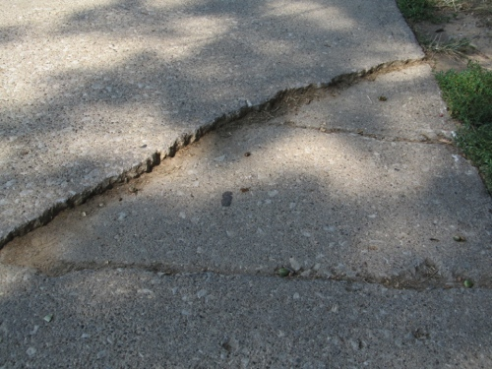
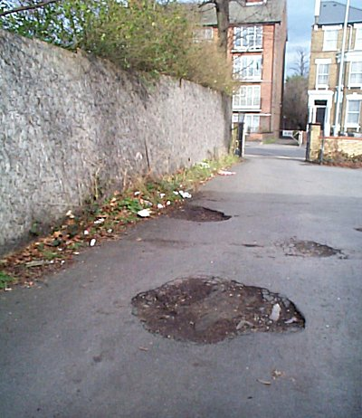
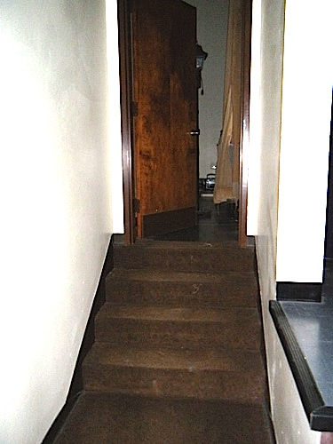
Fall Prevention
Walking Surfaces and Handrails
Surface defects
Debris
Poor design
Maintenance
Handrails provided
Notes:
Slips, trips and falls result in numerous injuries around the world and are the most frequent types of accidents at institutions, whether church, private or public.
They can be caused by surface defects related to design or maintenance, like unnecessary changes in elevation, where sidewalks are not the same elevation as the landings outside of doorways, potholes that have developed in parking lots, or cracked and raised concrete from settling and trees. Debris like gravel, branches, and leaves can also result in slips, trips and falls.
Missing and broken handrails at elevation changes and stairs can result in falls when an individual needs such assistance or anyone stumbles and has nothing to grab to keep from falling.

Slide 6
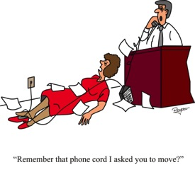

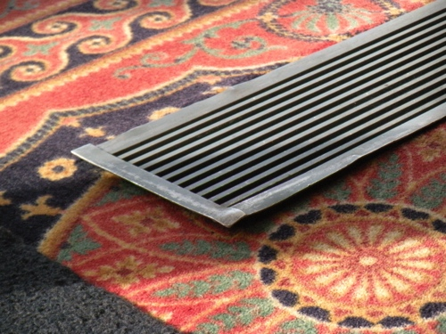
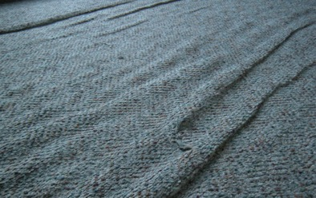
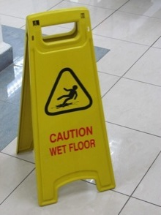
Fall Prevention
Walking Surfaces
Work processes
Housekeeping
Wrinkled carpets
Inclement weather
Notes:
Trips and falls may also be caused by cords across floors because electrical outlets are not available where needed, or by wrinkled carpets, floor vents or other issues.
Do employees leave boxes in corridors or file drawers open? Are other items tossed on floors where they can be tripped over? Are “Caution, Wet Floor” signs used to warn of a slipping hazard. Are freezer floors free of ice buildup?
Do we have preparations in place that will respond to inclement weather like rain, ice and snow. Mopping and signs, proper floor mats (not towels) and for some, ice and snow removal need to be considered and planned for well in advance.

Slide 7
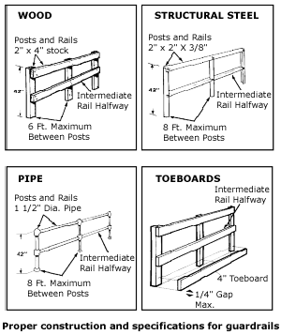
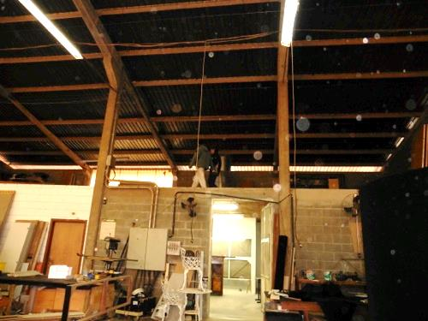
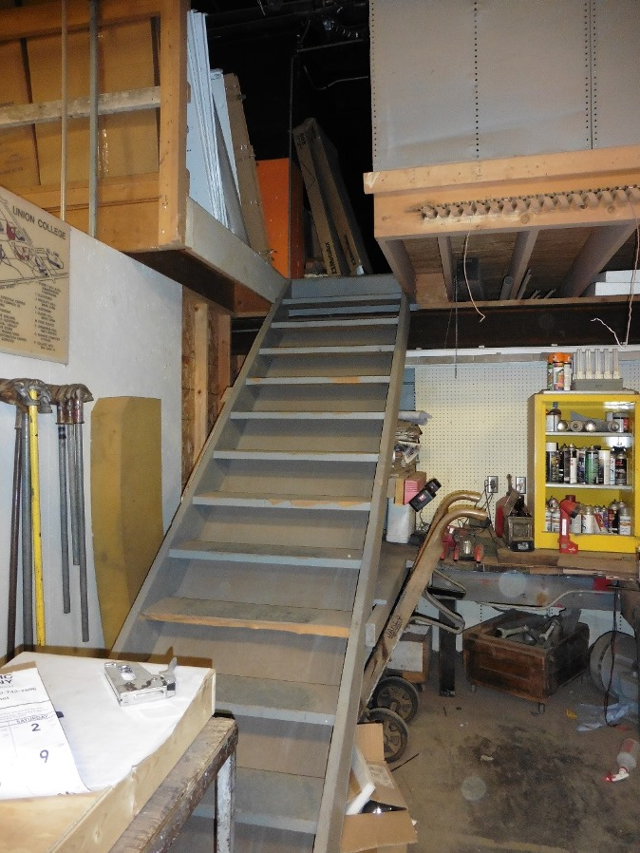
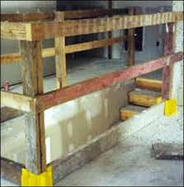
Fall Prevention
Elevations
Openings and drop offs
Missing handrails and guardrails
Defective or improper railings
Load ratings on mezzanines
Notes:
Falls from elevations are also a serious matter.
Floor openings and drop offs must be properly guarded. A little distraction and one can easily step off an edge. It happens all the time and leads to debilitating injuries and heavy financial losses.
Ensure that stairs have handrails and that open mezzanines and platforms have upper and mid rails and toe boards per CAL OSHA specifications.
NOTE: Mezzanines must also have load ratings posted.

Slide 8
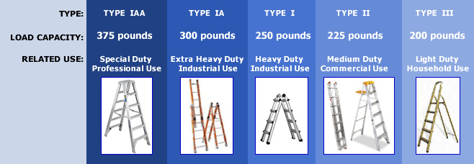
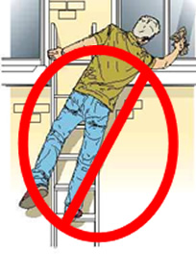

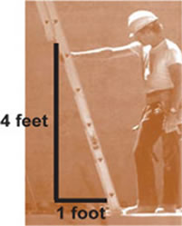
Fall Prevention
Elevations
LADDER ACCIDENTS
Inadequate Training
Ladder in poor condition
Improper selection, care or use including incorrect positioning
Unsafe work practices
Cal OSHA, Portable Ladder Safety etool, http://www.dir.ca.gov/dosh/etools/08-001/
Notes:
According to Cal OSHA documents, ladder accidents are usually caused by:
Inadequate training
Poorly maintained ladders
Improper selection, care and use of ladders (including positioning of the ladder)
Unsafe work practices
Train all employees in the proper selection and safe use of ladders.
Before use, check the condition of ladders ensuring they are clean and not defective. And set them up properly: The right angle with the base away from wall ¼ the height of the ladder or one foot for every four feet in height. The correct extension that leaves three feet beyond the roof overhang.
Using the right ladder for the job is crucial. Only non-conducting ladders are to be used when performing electrical work. Do not exceed ladder load capacities.
When climbing, maintain three points of contact, and do not work out of the center line of the ladder.
Use ladders to access those hard to reach areas. Leave the chairs for sitting and boxes for packing.

Slide 9
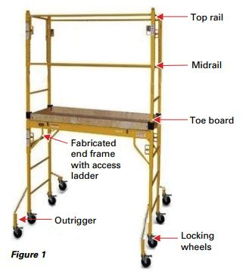
Fall Prevention
Elevations
Narrow Frame Scaffold Hazards
  Falls
  Tip-Overs
  Electric Shocks
  Structural Failure
Supported and Suspended Scaffolds
Notes:
Understanding the most frequent loss causes for scaffolds is important in helping to prevent injuries to employees. OSHA in their fact sheet lists the following as causes for loss with Narrow-Frame Scaffolds:
Falls from an elevated level
Tip-Overs
Electric Shocks
Structural failures (collapse)
Some similarities exist with hazards related to “supported“ scaffolds . There are also critical differences. Know the standards for them and “suspended” scaffolds, if used.

Slide 10
Fall Prevention
Elevations
Safety
  Trained and authorized
  Load limits scaffold components, casters, etc.
  Assess work area
  Pre-operation inspection
  Connections secure
  Lock wheels
  Proper railings
  Proper planks
  10 feet from energized electrical
  Outriggers: both sides if used
  Fall protection: working platform is 10 feet or higher
Notes:
Some of the recommendations for safe use of narrow scaffolds include ensuring that staff are trained and authorized to use the equipment.
Before setting up, assess the work area, site conditions and the work to be performed. Perform a pre-operation inspection on the scaffolding before use and ensure that load limits are met, connections are secure, wheels are locked, all railings are in place and planks are in good condition and meet the requirements for such use. Planks also need to fully cover the standing platform area.
Scaffolding also needs to be at least 10 feet from any energized power lines.
If outriggers are used, use them on both sides.
OSHA also requires fall protection if the working platform is 10 feet or higher.

Slide 11
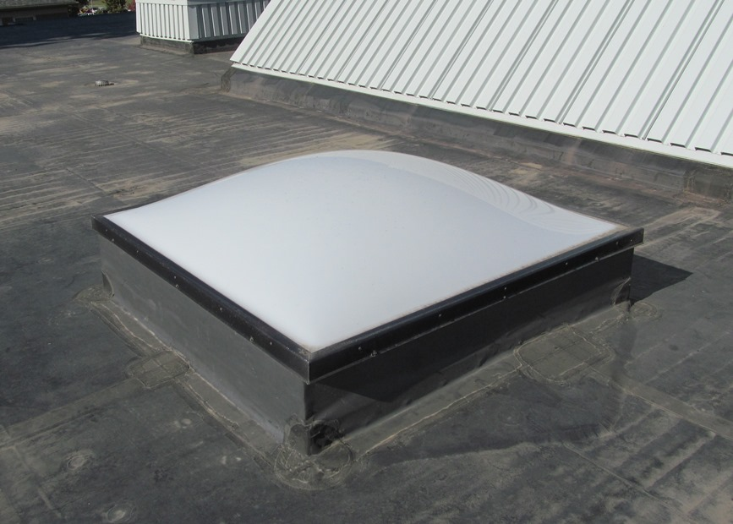
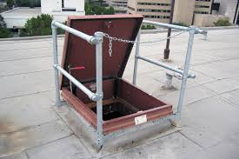
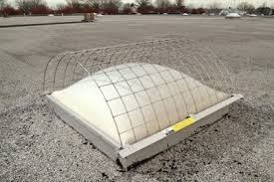
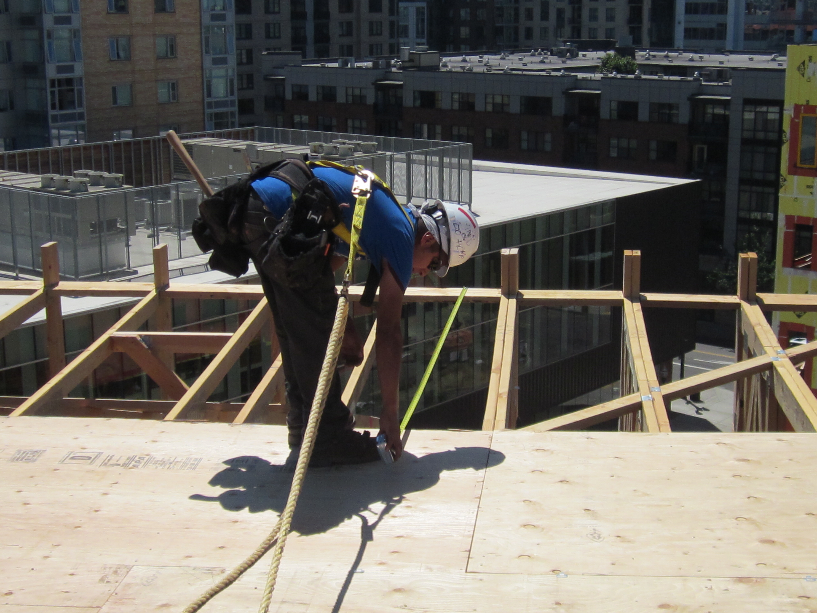
Fall Prevention
Elevations
Roofs
  Roof Access
  Skylights
  Roof Edges
    Permanent Guards
    Protection Harnesses
    Fall Protection Systems
  Variances
Notes:
Roof access hatches need to be properly guarded to prevent someone from inadvertently stepping into the opening. A sample permanent guard is shown here, although temporary railings are also available.
A look at OSHA reported deaths for 9/2012 through 9/2013 shows a considerable number of deaths from employees falling through skylights. One SDA academy also had a maintenance man suffer the same tragic fate a number of years ago. Where any employee will approach within 6 feet of the skylight, CAL OSHA standards call for the skylights to either be guarded or have a cage that will withstand an established weight limit without deflecting enough to break the glass below.
Guardrails are also required “at locations where there is a routine need for any employee to approach within 6 feet of the edge of a roof.” Where work is “intermittent” safety belts and lanyards or an approved fall protection system may be used in lieu of lanyards. The illustration in this presentation reflects both permanent guarding on the distant roof and the fall restraint system used by a worker.
NOTE: Trigger heights vary between General Industry and the Construction industry , as well as by the job performed within a particular industry. Study carefully how your buildings, job tasks and projects apply. They also may vary depending upon whether s task is routine (more than four times a year) or intermittent (work not exceeding four times a year.)

Slide 12
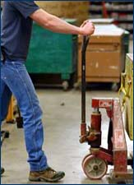
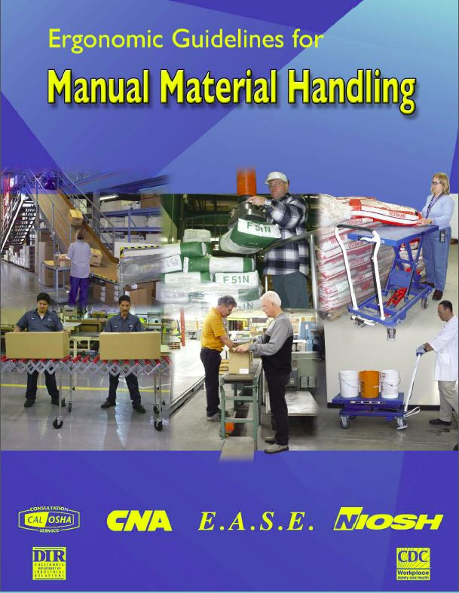
Reducing Strains
Material handling
Proper lifting
Movement
Push Don’t Pull
Storage and housekeeping
Assistance
Notes:
Many workers are injured each year when they strain themselves in the process of lifting and moving materials from one location to another.
It is important that we provide training on how to lift properly, how to move materials and how to store supplies in a way that works best with body structure and ergonomics. The free document, “Ergonomic Guidelines for Manual Material Handling,” available from the CDC at http://www.cdc.gov/niosh/docs/2007-131/, is an excellent source for such information.
Good storage and housekeeping are also crucial as we try to store heavier objects at waist level rather than have to raise or lower items as we place them on or remove them from shelves. Poor housekeeping at the same time requires workers to have to maneuver through items and may cause them to possibly move or turn wrong while handling the load.
Workers need to avoid “macho” tendencies when performing tasks. When objects are awkward or heavy the employee should seek the assistance of another employee.

Slide 13
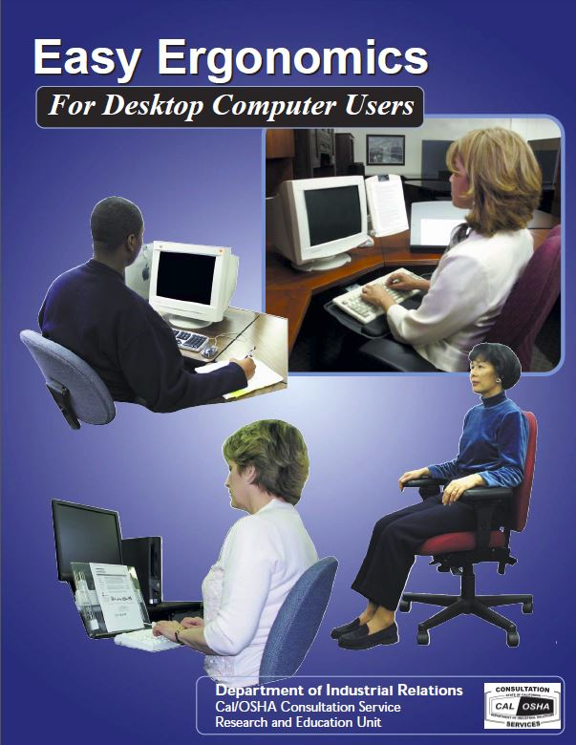
Computer Workstation Ergonomics
Body positions
Flexible station setup (multiple users)
Notes:
Ergonomics in the office is also important as evidenced by numerous carpel tunnel claims, complaints of back and neck pain and other employee issues.
Each workstation needs to be set up for the operator so that body positions are correct to prevent injuries.
Where a workstation supports multiple users, efforts should be made to provide adjustable keyboard tables, chairs and other features that can support individuals of different heights and body structures.
A good source for determining computer ergonomic needs in the workplace is “Easy Ergonomics for Desktop Computer Users” provided by CAL OSHA.

Slide 14
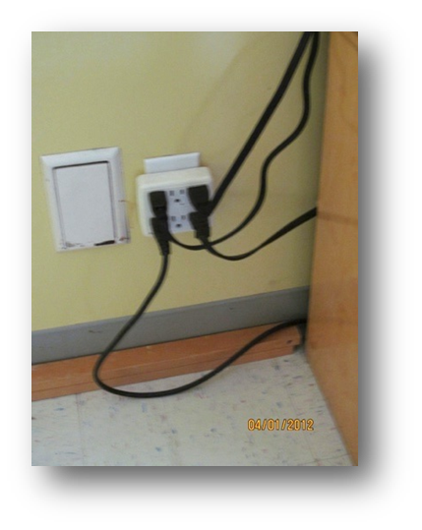
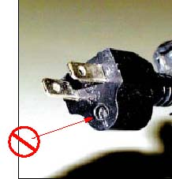
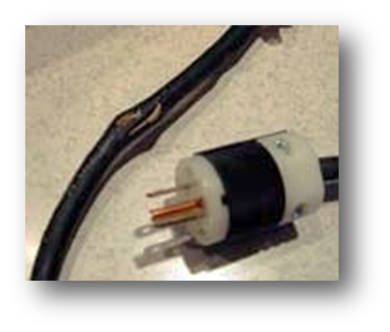

Don’t Be Shocked!
Electrical Safety
Per NEC and other standards
Extension cords/temporary only
Properly grounded
Electrical in good condition
Hand tools in good condition
Ground Fault Circuit Interrupter protection (GFCI)
Notes:
Equipment and wiring practices that do not meet electrical code or fire safety standards are often observed during surveys.
Extension cords are designed for temporary use only – generally 90 days maximum. Christmas is a good example of a use that might fall into the ninety day range. A construction site is another. Wiring to desks and for other similar purposes should be with the use of protected power strips. Do not “piggyback” power strips and do not use octopus or multi-plug outlets.
Wiring must also be properly grounded. Repair or replace wiring on tools and other equipment if the ground prong is broken off or wiring is damaged.
Provide ground fault circuit interrupter protection (GFCI) within 6 feet of sinks, in garages, outdoor outlets and other wet or damp areas, as needed, including RV hookups.
Portable GFCI cords are available for those times when one must plug into a standard outlet to perform work outdoors or in a damp area.

Slide 15
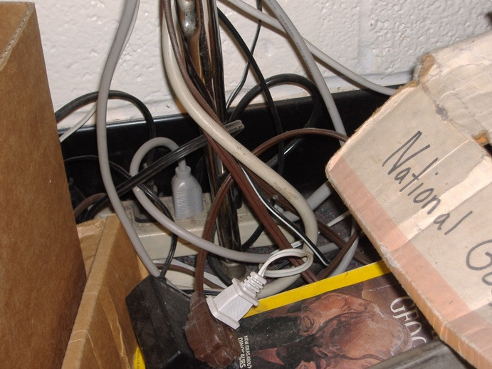
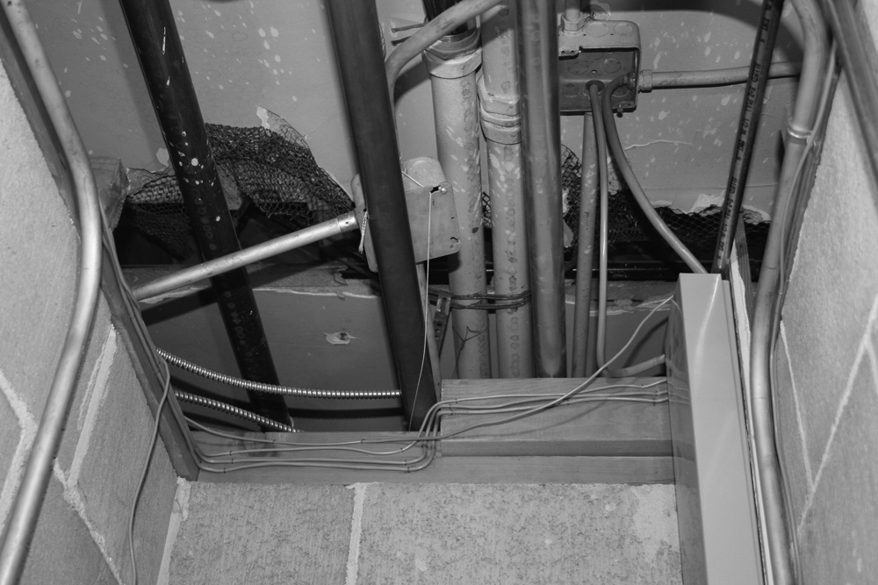
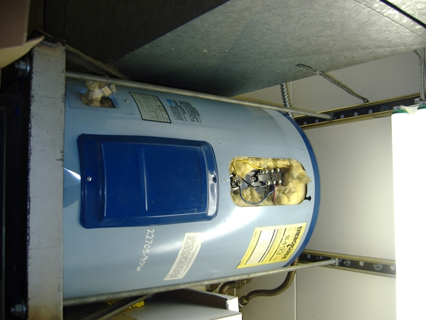
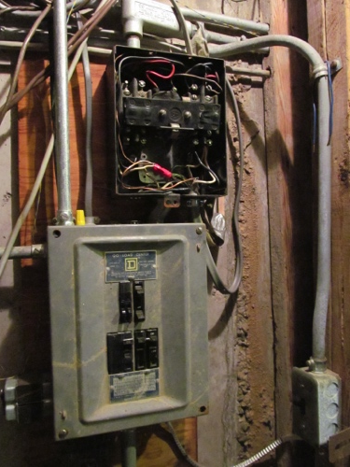
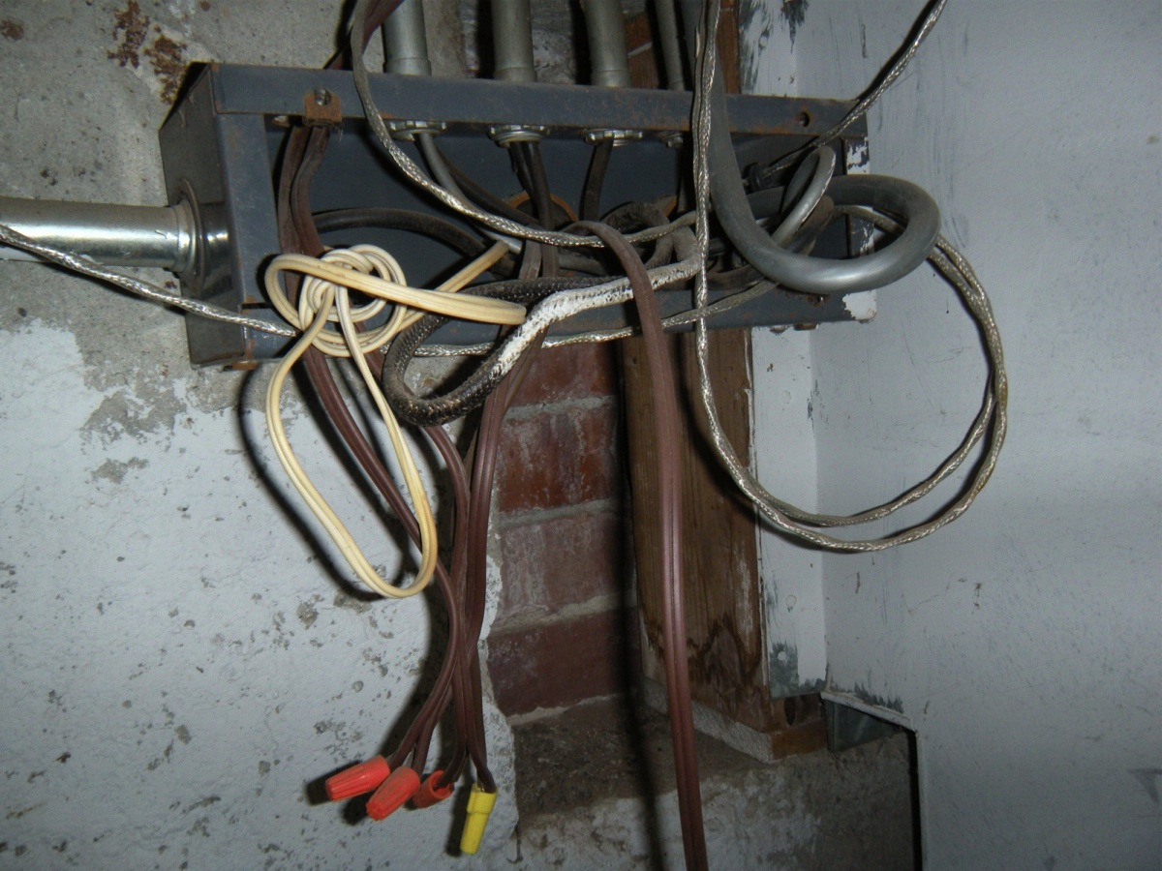
Don’t Be Shocked!
Electrical Safety
More Observations
Notes:
Replace covers on electrical boxes, access plates, outlets and switches.
Also look for areas where poor housekeeping and electrical conditions could result in overheating and fires.
Where there are poke throughs for electrical, computer wiring or plumbing, fill them with a fire retardant sealer and replace sheetrock to regain the original fire and smoke separation from other parts of the facility.

Slide 16
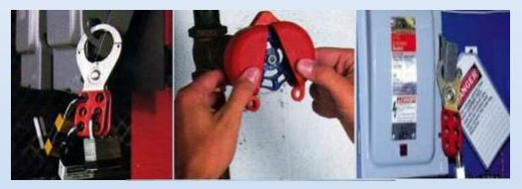
Lockout/Blockout/Tagout
Hazardous energy
  Electrical
  Steam
  Hydraulic
  Gas
  Gravity
Notes:
We are all familiar with the dangers of electricity and the need to shut down, lock out the power source and tag it, but hazardous energy comes in many forms, all of which can cause serious injury or death.
Steam, hydraulic pressure, gas and even gravity are all considered potentially hazardous energy sources and must be treated as such during repairs.

Slide 17
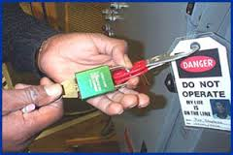
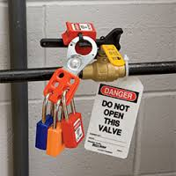
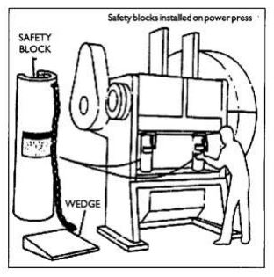
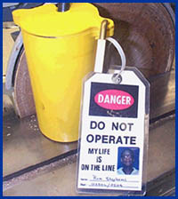
Lockout/Blockout/Tagout
Disconnect
Release energy (hydraulics, steam, etc.)
Lockout/Blockout
  Various devices
  Separate locks
Tag
Notes:
When working on a machine or system, shut down the source of power or energy, release the energy, whether steam, gas, hydraulic, etc., and lock it out. There are devices for locking out circuit breakers, switches, valves and other devices. Keep a variety in stock for all needs.
Blocks are available and must be used where gravity can result in an individual being crushed while working on machinery or vehicles.
All individuals working on a locked machine must install their own locks and tag accordingly.

Slide 18
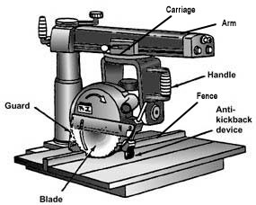
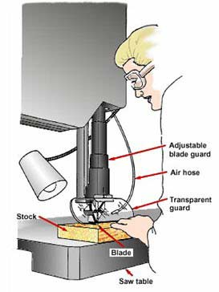
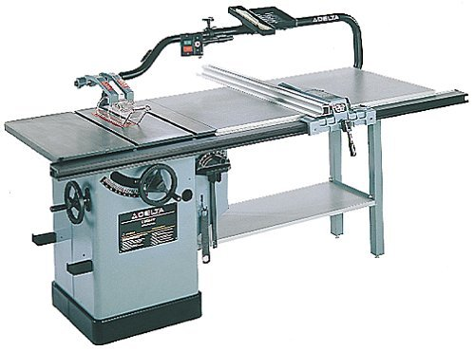
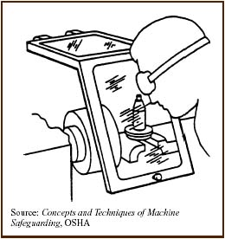
Machine Safety
Pinch and nip points
Point of operation
Machine characteristics
Retrofit guards
Disconnect and lockout
Walkways and working space
Electrical Cords
Notes:
Guarding all pinch and nip points is crucial to reducing machine related injuries like crushing and amputations.
Guards must protect employees from drive wheels, gears and pulleys and point of operation hazards where flying parts or debris could cause injuries.
Some machines also require two hand operation to avoid having fingers near shears and other similar hazards.
Retrofit guards are available from a number of suppliers. Where a guard cannot be obtained, machines should be replaced.
Disconnect and lockout unguarded, hazardous equipment.
Provide workspace around equipment that allows a safe, uncluttered working area for employees and provides a safe walking area for others in the area.
Check for electrical cord damage, particularly where cords come out of motors and equipment.

Slide 19
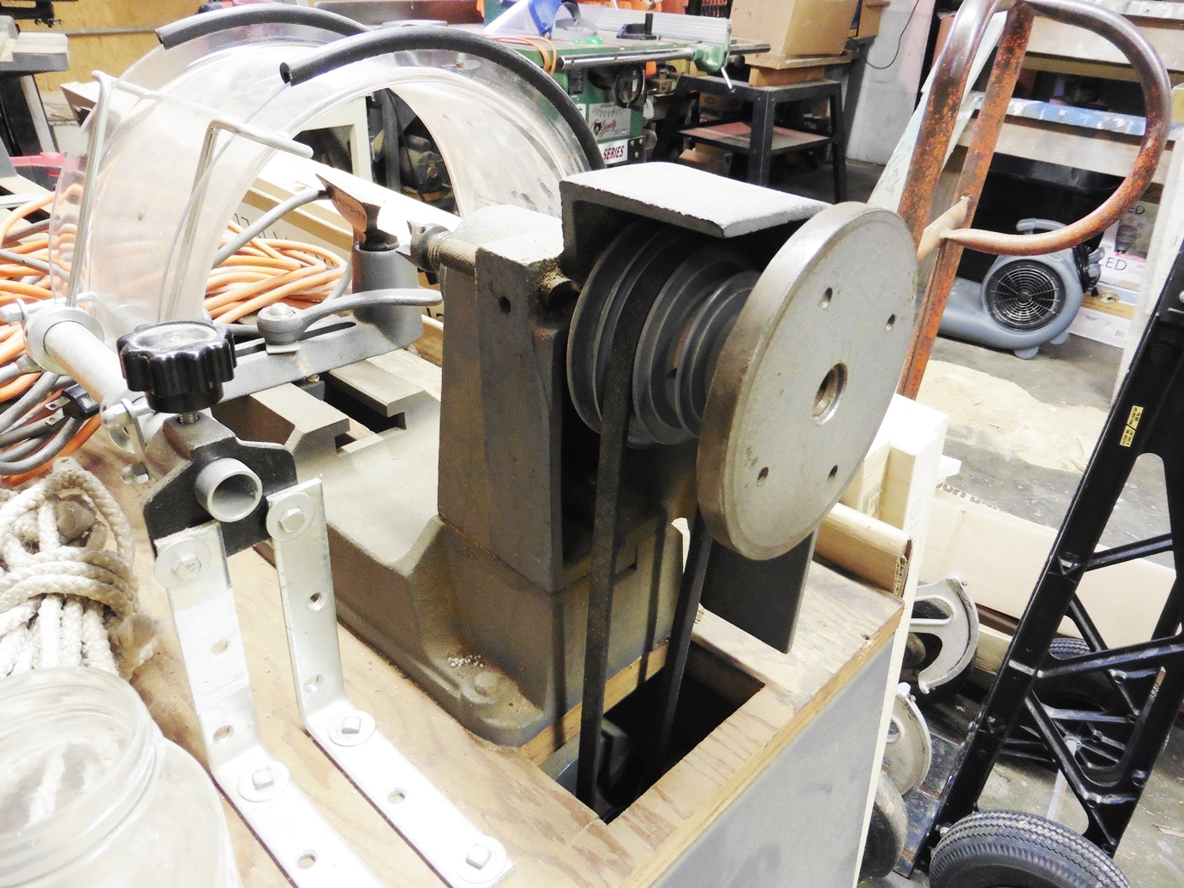
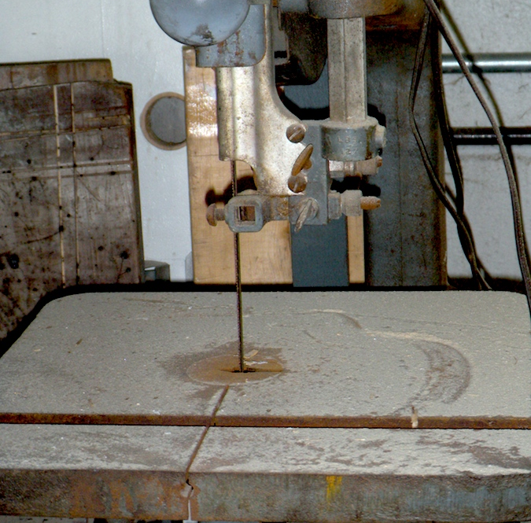
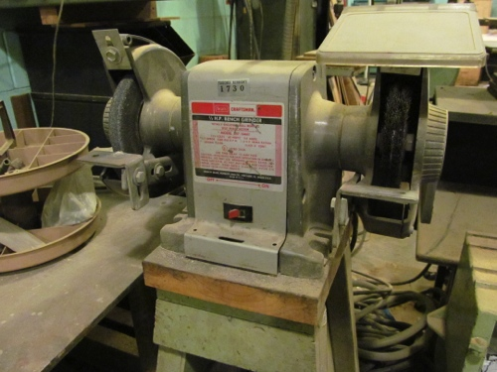
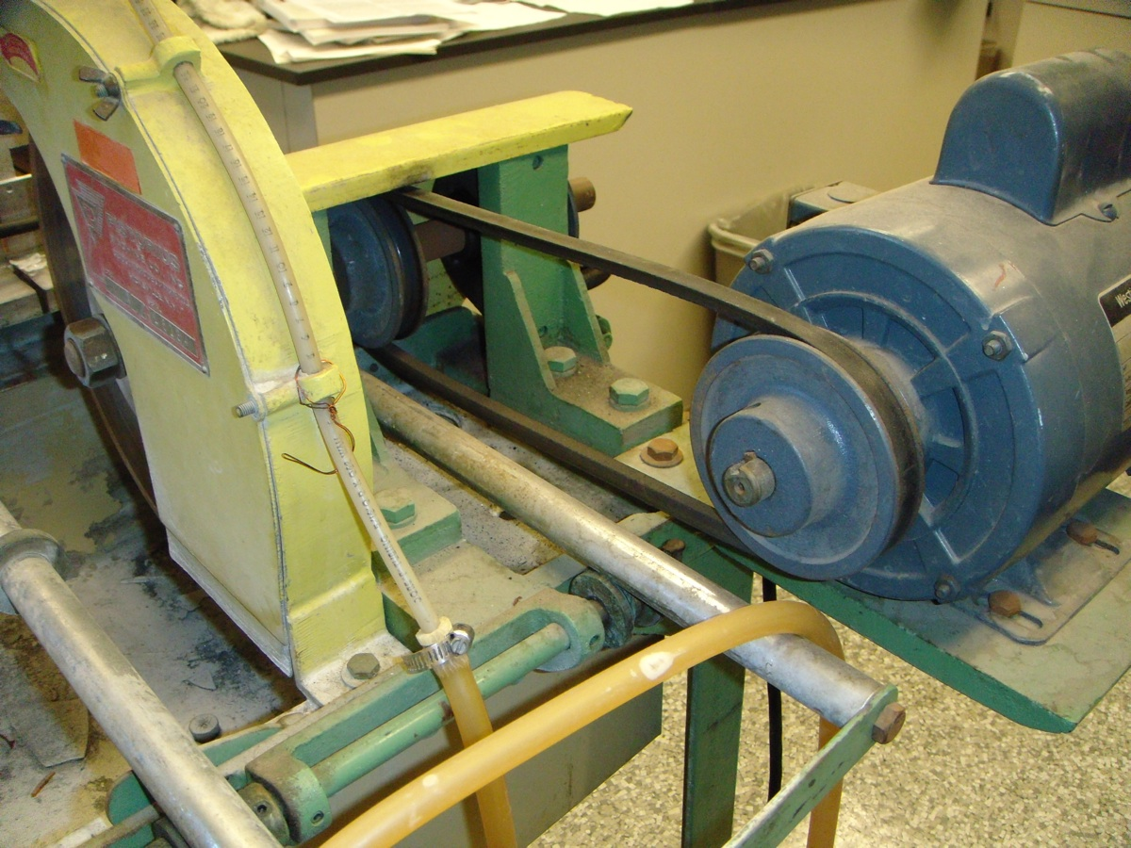
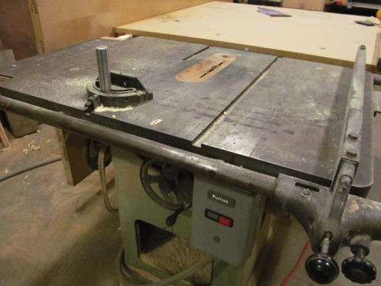
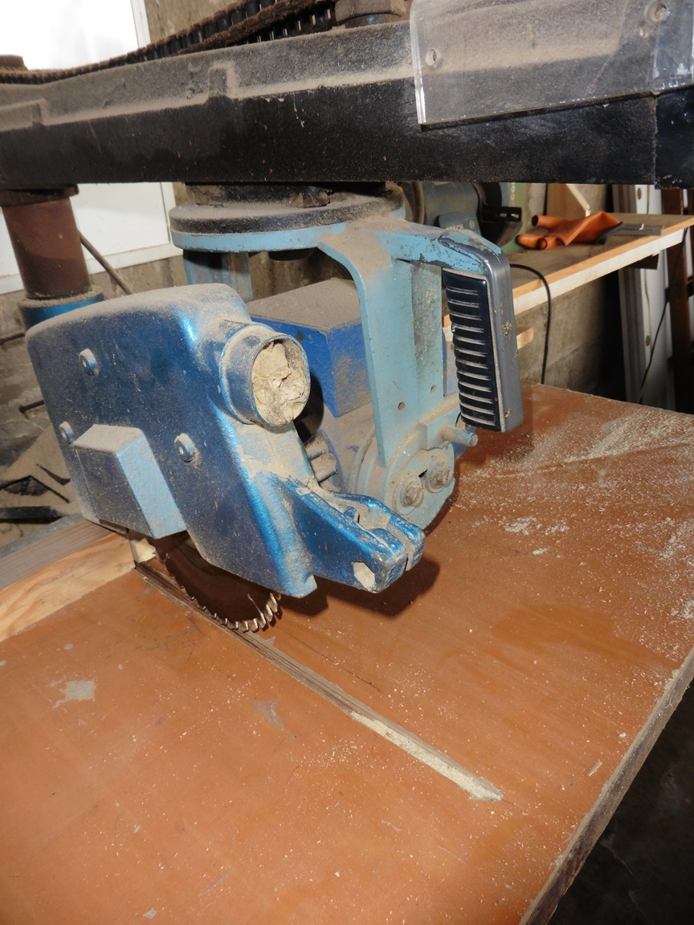
Machine Safety
Sample Campus Equipment
Notes:
Additional samples of unguarded machines are illustrated in this slide. On band saws, only the portion of the blade doing the cutting can be exposed.
Grinders must have side guards, tool rests and upper tongues and all must be properly adjusted.
The lathe in this picture has Point of Operation shielding, but the adjustable drive pulleys and belt are exposed. In the same manner, the drive pulley for a table saw is also exposed.
The table saw has no guard over the blade and no anti-kickback fingers. The radial arm saw also has no lower guard or anti-kickback fingers. In addition, the radial arm saw did not return to its starting point when released.

Slide 20
Transportation
Drivers Trained
Observed
Vehicle Maintenance
Records
Forklift Certification
Key Removal
Notes:
One of the quickest ways to bring on an accident is to put an untrained driver behind the wheel of a vehicle or other equipment. Ensure they are qualified by providing “hands on” training and periodic observations as they perform their tasks.
Provide vehicle maintenance that conforms with manufacturer specifications and transportation laws, as applicable, and maintain thorough records. Records can be requested during lawsuits following accidents.
All forklift drivers must be trained and certified per CAL OSHA standards.
Numerous vehicle and equipment accidents have occurred when unauthorized students or adults found the keys still in the ignitions and drove off. Pull keys from the ignition when getting out of vehicles. When parking them at night, pull the keys and keep them in a lockbox or hang them in the office.

Slide 21
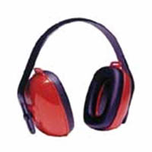

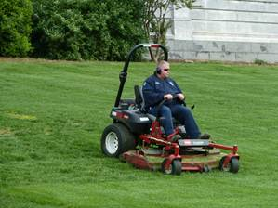
Groundskeeping
Training (documented)
PPE Provided
PPE Enforced
HazCom standard addressed
Heat Illness Preventionhttps://www.dir.ca.gov/title8/3395.html
Seat belts used
Tractors: ROPS and belts
Notes:
By the nature of their jobs, groundskeepers are exposed daily to moving blades, flying debris, loud noises, heat, insects and even hazardous chemicals.
Ensure that all groundskeepers are properly trained for all equipment used in their jobs and are provided personal protective equipment (PPE) for all hazards they might be subject to, including, safety glasses or goggles, hearing protection, gloves and other items. They should also wear steel toed work boots when operating lawnmowers and other equipment that can harm feet.
Observe employees and enforce the use of PPE.
Train employees who handle chemicals and ensure they understand the dangers and how to safely use them. Train them also in how to read and understand safety data sheets as applies to the materials they will be using. Document all training.
Because they work outside in the elements all day, they must also be aware of the dangers of heat illness, should wear hats and sunscreen and take periodic breaks to cool down. They must also drink plenty of water to stay well hydrated. OSHA statistics report numerous deaths from heat affecting groundskeepers and others.
Where seatbelts are provided on equipment, they must be used. Ensure also that any tractors have rollover protection and seat belts.

Slide 22
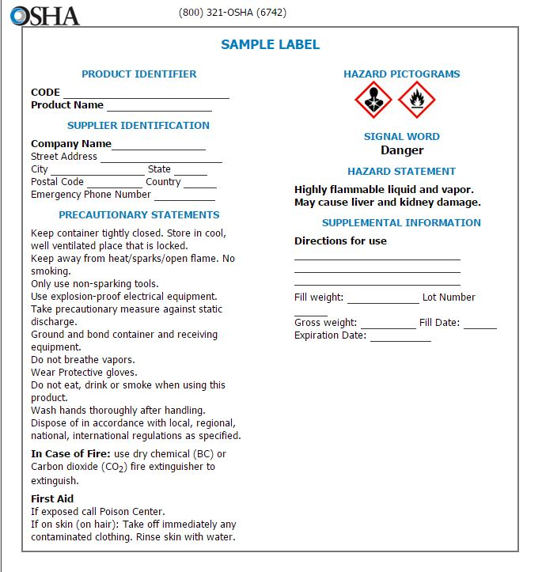
Hazard Communication
Identifies hazardous chemicals
  Acute toxicity
  Skin corrosion/irritation
  Germ cell mutagen
  Serious eye damage/irritation
  Carcinogenicity
  Reproductive Toxicity, etc.
  Aspiration hazard
Labeling
Inform and train
Notes:
This slide illustrates the types of dangers found in various chemicals classified as hazardous by OSHA. They are:
Acute toxicity
Skin corrosion/irritation
Germ cell mutagen
Serious eye damage/irritation
Carcinogenicity
Reproductive Toxicity, etc.
Aspiration hazard
Ensure that chemical containers are properly labeled.
Inform and train employees who will use these chemicals as to each chemical’s dangers, required PPE and how to work safely with them.

Slide 23


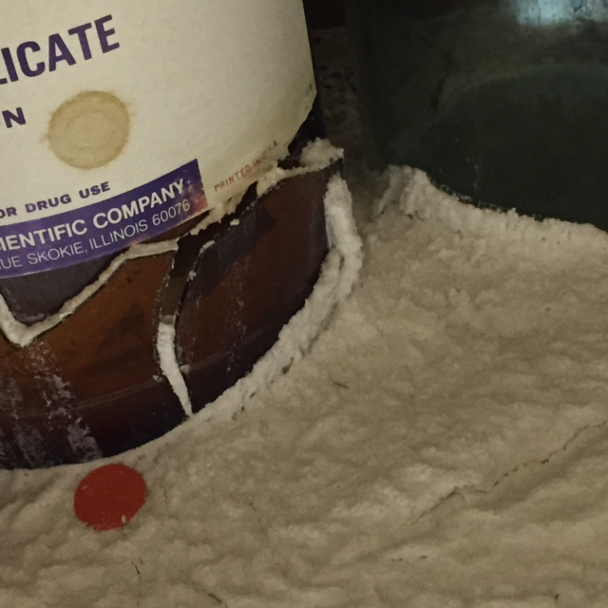

Chemicals and Safety Data Sheets
(Material Safety Data Sheets)
Inventories
Properly stored
Outdated removed
Proper disposal
SDS Readily accessible
Current
Understood
Notes:
All chemicals on campus should be on an inventory list and Safety Data Sheets (SDS) available for each.
Good chemicals need to be properly stored on shelves, in flammables cabinets or in acids cabinets, as applicable. Ensure shelves have lips designed to keep bottles and chemicals from being knocked or shaken off by an earthquake. Outdated chemicals should also be removed and disposed of properly through a hazardous waste contractor/facility.
Safety Data Sheets (SDS) must be periodically updated replaced when changes take place.
Ensure that employees know how to read the SDS, particularly where they list hazards, how to safely use the chemical and what personal protective equipment should be worn.
Safety Data Sheets must also be readily available to employees. Copies should be kept in maintenance, janitor closets, chemistry and other laboratory and other areas close to the point where employees use or mix them.

Slide 24

Personal Protective Equipment (PPE)
Provide PPE
  Eye Protection (Safety glasses, goggles, face mask, etc.)
  Gloves
  Harnesses
Notes:
This page illustrates some of the types of exposures that can present themselves, and PPE that is available to help prevent contact.
Remember:
Provide PPE
Train how to properly use PPE
Enforce the use of PPE

Slide 25

A Major Role
Everyone
Preventive Maintenance
Right the first time
Fire safety equipment
Observation
Correction
Notes:
We each play a major role in safety on our campuses. Yes, we have budgetary limitations nearly everywhere, but there are ways to help reduce costs and enhance safety.
As we all know, well-maintained facilities are safer facilities and preventive maintenance is generally less expensive than repair or replacement.
Doing things right the first time is also important to safety. Once an electrical job is done, covers need to be reinstalled. Poke throughs for electrical runs should be sealed immediately. Put parts and equipment away when finished.
Install and maintain fire safety equipment, as required, and keep egress aisles clear.
We can each remain observant to conditions on campus. If we see a hazardous condition, report it. From my experience in maintenance I could usually take a mental or written note, and either fix an issue myself or have one of my crew do it. Leaving something unfixed, is just a step toward disaster of some kind.

Slide 26
Resources
www.adventistrisk.org
http://www.dir.ca.gov/dosh/puborder.asp
http://www.dir.ca.gov/dosh/etools/08-001/care.htm (Portable ladder safety Inspection, Use and Maintenance)
http://www.cdc.gov/niosh/, Occupational Safety and Health
Notes:
There are numerous resources out there to assist us in accomplishing our responsibilities and keeping people safe. These are just a few, but in today’s electronic world the answers are usually right at our fingertips.
ARM has resources on our website, as does the CDC, CAL OSHA, federal OSHA and others. It is pretty easy to build your library and save information electronically or even as a hard copy if you prefer.

Slide 27

The information contained in this presentation is based on general risk management principles and does not constitute legal advice or an endorsement of any products, services or course of action. Risk management planning will vary with each organization. It is the responsibility of the attendees to make their own decisions about the reliability and correctness of the information provided in this seminar.

