Slide 1
CURRICULUM ADD-ONS
Aluminum recycling
Alcohol/drug addiction
Head lice prevention
Sex education
Plant-a-tree program
Poison prevention program
Hand gun safety
Earthquake safety education
Flood safety education
Tornado safety education
Hurricane safety education
Nutrition education
Electrical hazard prevention
Fire safety program
On-line pornography education
Manners education
Divorce education
Death education
AIDS education
Emergency numbers program
Gunfire safety program
Suicide prevention program
Alternative family education
Sex abuse prevention program
Air/water pollution program
Garbage recycling education
Tolerance education
Lead poisoning program
Nay, Nay to 900 numbers, “stay away” program
Be kind to animals program

Slide 2
CURRICULUM ADD-ONS
Personal hygiene
Lighting safety program
Mine/cave safety program
Carbon monoxide safety program
Acid rain education
Save the owl
Save the whale
Save the manatee
African bee awareness week
CPR/Heimlich training
Energy conservation
Personal safety
Save the rainforest
Multicultural awareness
Violence prevention programs
Sexual harassment education
Gender equity education
Holocaust awareness education
Don’t talk to strangers program
Escalator safety education
Restitution education
Conflict resolution
Responsibility training
Lyme disease prevention
Firecracker safety education
Condom education
Drowning prevention education
Toy safety program
Frostbite prevention education
Character education

Slide 3
CURRICULUM ADD-ONS
Safe sledding education
Practice safe sun education
“Just say no to Satan” program
“Just say no to kissing”
Homeless education awareness program
Snow plow safety program
Railroad crossing education
Garage door safety program
School bus safety
Practice safe tattooing
Body piercing safety
“No gangs for me” program

Slide 4
DIFFERENTIATED INSTRUCTION IS NOT…
An IEP for each student
Unstructured
Another word for tracking
Giving additional busy work to accelerated students
Watering down the curriculum
A program, model, or recipe

Slide 5
DIFFERENTIATION
Differentiation is a teaching concept in which the classroom teacher PURPOSEFULLY plans for the diverse needs of students.
IT IS A JOURNEY YOU TRAVEL AS YOU DEVELOP THE SKILLS OF BEING RESPONSIVE TO THE DIFFERENT LEARNING NEEDS IN YOUR CLASSROOM.

Slide 6

THE JOURNEY
NOT
DIFFERENTIATED
FULLY DIFFERENTIATED
*Ongoing Assessment
*Flexible Grouping
*Tiered Assignments
*Anchor Activities
*Curriculum Compacting
*Learning Stations/Centers
*Project-Based Learning
*Independent Study
*Learning Contracts
*Problem-Based Learning
One Size Fits All

Slide 7

Essentials of a Differentiated
Curriculum
Curriculum can be defined as what students are expected to know, understand, and be able to do.
KUDOS
The foundation of any curriculum is factual knowledge.
Factual knowledge is what we want our students to KNOW. It is the information that grounds the student in the discipline.
Notes:
The foundation of any curriculum is factual knowledge.
Factual knowledge is what we want our students to KNOW.
It is the information that grounds the student in the discipline.
Knowledge of:
Terminology (Vocabulary, music symbols)
Knowledge of specific details (Major natural resources)
Elements (Chemical elements)

Slide 8

Essentials of a Differentiated
Curriculum
  Procedural knowledge is what we want our students to do.
  Procedural knowledge includes knowledge of strategies, skills, and processes.
Notes:
Next up the curriculum pyramid—based on Bloom’s Taxonomy—is procedural knowledge.
Procedural knowledge is what we want our students to do. Procedural knowledge includes knowledge of strategies, skills, and processes.
Example: Reading is a skill. Within the skill of reading are the strategies of comprehension, inference, interpretation, analysis, decoding and so on. The reading process employs various strategies before, during, and after reading. To be a skilled reader, one needs to holistically develop the numerous strategies embedded within the skill.

Slide 9
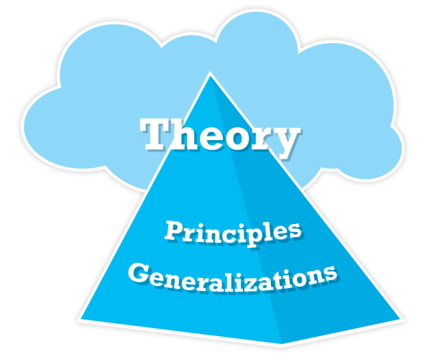

Essentials of a Differentiated
Curriculum
  Conceptual knowledge is what we want our students to understand.
  Conceptual knowledge builds on factual and procedural knowledge, but requires more critical and creative thinking..
Notes:
The next tier of the curriculum is conceptual knowledge, followed by generalizations, principles, and theories. These are the parts of the curriculum that include the things we want students to understand. They build on factual and procedural knowledge but require more of students in terms of critical and creative thinking. Students must analyze, make connections, conceptualize, synthesize, and evaluate information in order to understand and make sense of it.

Slide 10
Use KUDOs to Unpack CCSS
Know Goals (factual knowledge) | Understand Goals (conceptual knowledge) | Do Goals (procedural knowledge)
Facts, dates, academic vocabulary, key people or key places | “Big ideas” or theories: “I want my students to understand that…” | Start with a verb, often from Bloom’s Taxonomy (apply, analyze, etc.)
Reviewing curriculum through this lens:
Focuses equal amount of instructional attention on factual, procedural and conceptual levels of learning
Gives opportunities to differentiate instruction based on students’ readiness
Helps move all students toward higher level thinking and understanding of content as required by CCSS
Notes:
To develop meaningful instruction based on appropriate student objectives it’s useful to unpack the standards.
For most of us, that now means Common Core State Standards for ELA and math and state standards for other subjects. As you may already know, the CCSS require some fairly major shifts in teaching and learning.
KUDOs are a useful tool for writing standards-based learning goals for a course, unit, or daily lesson. We’ll use a graphic organizer like this as we practice. To find your graphic organizer, turn to page R12 in the Appendix of your Resource Book. We’ll use it in a few minutes.
Reviewing curriculum through this lens:
Focuses equal amount of instructional attention on factual, procedural and conceptual levels of learning
Gives opportunities to differentiate instruction based on students’ readiness
Helps move all students toward higher level thinking and understanding of content
Know (Factual Knowledge) facts related to a study
Understand (Conceptual Knowledge) big ideas
Do (Procedural Knowledge) what students will be able to do independently by the end of the course, unit, or lesson

Slide 11
Tips for Sharing Learning Goals That Students Understand, Remember & Personalize:
  Do not write the goal on the board and assume students will pay attention to it.
  Do have students paraphrase goals in their own words.
  Do make sure you are sharing goals and not just activities.
  Do share criteria for evaluation.
1.
2.
3.
4.
30
Notes:
Go through the four secrets for sharing learning goals with students and reference the previous brain gym activity.
Click to reveal tips.
Recall that I didn't simply write the brain gym goal on a piece of chart paper, but rather I made you aware of the goal.
I asked you to paraphrase the goal.
My goal was stated as a learning objective that I wanted you to achieve. I didn't give a list of activities we would do.
Lastly the only criteria that I did share was that I wanted full participation and for you to be able to share the reason we did the brain gym activities.

Slide 12
What’s the point?
Readiness Interest Learning Profile
GROWTH AND ACHIEVEMENT
MOTIVATION
EFFICIENCY

Slide 13
WHAT CAN BE ASSESSED?
READINESS | INTERESTS | LEARNING PROFILE
Skills Content Concepts | Hobbies Likes Dislikes | Social/Emotional Factors: *Language *Culture *Health *Family Circumstances *Special Circumstances Learning Modality Cognitive Preference

Slide 14
ASSESSMENT FOR READINESS
Assessment takes various forms that support instruction in different ways.
Pre-assessment helps teachers determine students’ current levels of readiness and is used to plan appropriate instruction.
Formative assessment allows teachers to accumulate information about students’ progress and is used to guide instructional decisions.
Summative assessment measures students’ progress at the end of a unit of study and is used to determine whether the criteria of the standards have been met.
Pre-assessment and formative assessment are critical tools for differentiated instruction.
Notes:
Explain that assessment takes various forms that support instruction in different ways.
Pre-assessment helps teachers determine students’ current levels of readiness and is used to plan appropriate instruction.
Formative assessment allows teachers to accumulate information about students’ progress and is used to guide instructional decisions.
Summative assessment measures students’ progress at the end of a unit of study and is used to determine whether the criteria of the standards have been met.
As responsive educators, assessment must continuously inform our teaching. Pre-assessment and formative assessment are critical tools for differentiated instruction, so these are the two forms of assessment we’ll spend time on during this workshop.

Slide 15
EXIT CARD PROMPTS
Promote Student Self-Assessment
I was confused by…
This reminded me of…
I wonder why…
I learned that…
I was surprised…
I predict…
A better way for me to learn this….

Slide 16
Exit Cards
Draw an illustration or make a graphic organizer of today’s lesson.
The most important thing about _______ is ____________.
How did today’s work connect to the work we did yesterday?
Pick any object and write a metaphor explaining how it compares to a concept in today’s lesson.
I want to start tomorrow’s class with the most important learning from today. What would it be for you?

Slide 17
The Frayer Model
Frayer, Frederick, Klausmeier, 1969
Essential Characteristics | Non-Essential Characteristics
Examples | Non-Examples
Topic
46
Notes:
You may be familiar with this as a strategy for teaching vocabulary. It’s also a terrific tool for formative assessment.

Slide 18

What Learning Profile
IS and IS NOT
IS
IS NOT
Cognitive preference
Learning modes
Gender
Culture
Fixed or singular
Used to classify students

Slide 19
Synthesis Task Card
CCSS Reading – Literature 5.2
Determine the theme of the story.
Groups of four with different modalities or cognitive preferences | Agree on the theme of the story
Four ways to express the theme | Be ready to present Make sure everyone can interpret all the work
76
Notes:
Strategy: Synthesis Task Cards
An easy way to expose students to a variety of cognitive preferences and modalities is through Synthesis Task Cards.
Begin by grouping students with different modalities or cognitive preferences together in small groups.
Ask students to agree on a key understanding of some content you are working on. For example, each group agrees on the theme of a story read in class (CCSS ELA Grade 5 Literature).
Then ask students to work as a group to generate four different ways they could express their understanding (essay or report, presentation, poster, etc.). As students work, tell them they will present their various ways of expressing understanding to the class. Each group member will have two minutes to share his product. By grouping students the way you have, each group should have a variety of products based on the learning profile of each group member.
Activity: If time allows, combine a synthesis task card with the next slide to reflect on what they have learned about differentiating by learning profile and interest. Participants can meet in their candy groups.
19

Slide 20

A WAY TO DIFFERENTIATE FOR STUDENT INTERESTS
CHOICE
Product choices
Ways to study vocabulary
Ways to work: alone or with a partner
Books to read
Authors to study
Order of tasks
Where to sit
Writing prompts
Anchor activities
Spelling Words
Roles
Due Dates
Learning Goals
Homework assignments
Choice of groups
Questions to answer
Ways to learn content

Slide 21
Tiered Assignments
Loosened Tier
Support is needed in order to reach the standard
Just Right Tier
Instruction and Practice is needed to reach the standard
Tightened Tier
Demonstrated mastery of standard. More depth and complexity is needed to enrich the standard
Notes:
21

Slide 22
The Less Complex Energizer
1 | 2 | 3 | 4 | 5 | 6
L | R | B | R | B | L
7 | 8 | 9 | 10 | 11 | 12
B | L | R | L | B | R

Slide 23
The Just Right Energizer
1 | 2 | 3 | 4 | 5 | 6
L | r | B | r | l | R
7 | 8 | 9 | 10 | 11 | 12
B | l | R | b | r | l

Slide 24
The More Complex Energizer
1 | 2 | 3 | 4 | 5 | 6
L | r | B, | R | l, | R
7 | 8 | 9 | 10 | 11 | 12
B | l, | R | b | r, | l

Slide 25
WHAT DID I DO?
Select concept that is focus of lesson
Used exit cards as formative assessment
Designed the “just right” activity: interesting, promote understanding of concept, where most students would be challenged
Designed the other two activities to vary in complexity to meet readiness levels
Changed the nature of the assignments
Made the tasks respectful

Slide 26
Tiering: An Example in PE
Skill: Dribbling in basketball
More Complex: Dribble with one hand while another student plays defense, increase speed, trade roles
Just Right: Dribble in and out of cones as quickly as possible using one hand, change hands and repeat, increase speed.
Less Complex: Dribble from point A to B with one hand, switch hands and repeat, develop a new floor pattern (not a straight line) using either hand.

Slide 27
Skill Based Readiness
Basic Order of Operations
9- (9-8) = | (8x8)x2= | (4x8) + 10=
4x(1-4)= | 9x (2-2)= | 8-(4-3)=
(8x8)-8= | (4x5)+4= | (8+10)-3=
Advanced Order of Operations
1- (7x5) - 4= | 10x(6-6)+10= | (4+4-1)-7=
(5-7)-(5x5)= | (4+5+6)= | (4 x6) + (4-5)
(5x9+2) x4= | (5-10) x (8x 8)= | (1+2) x ( 3-2)

Slide 28
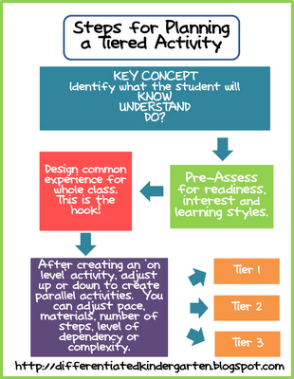
Pre-Assess for Readiness

Slide 29
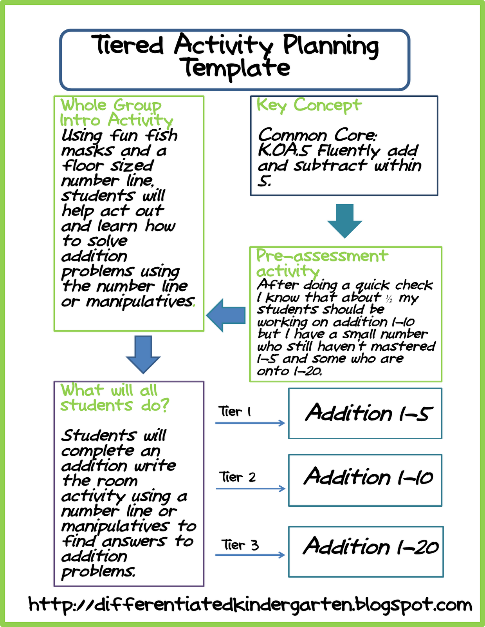

Slide 30
Literacy Contracts
Dear ___________
Next week while reading your book, please think about one of the ideas listed below. Put an X next to the idea you choose and then write me a letter with your thoughts about it. Please give your letter to me by next Friday. I am looking forward to reading what you are thinking. Please ask me if you have any questions.

Slide 31
_____Pick one character that you think is interesting. Write about how the character reminds you of someone you know. Write also about times when you’ve been most like this character.
_____What connections can you make between your book and experiences you have had or to other books you have read?
_____How does the setting affect the characters and their actions in the book?
_____Really good writing captures your attention. Tell me some examples where your book surprised you or hooked you into reading. In your opinion, what is the quality of the writing in your book?

Slide 32
_____ Pick one character that you think is interesting and tell me about this character.
_____ A good reader thinks about what he or she reads. What is something you think is really important or interesting in your book? Tell me why you think so and give me some examples.
_____Describe the setting of your book and why you think it is important.
_____A lot of good writing puts pictures in your mind. What pictures does your book put into your mind?

Slide 33
_____Pick one character and give that character advice at this point in your book. Defend why you think that’s good advice. Do you think the character would accept your advice? Why or why not?
_____What’s an insight you had while reading or what connection did you make between the book and your life? (or life in general)
_____Think about how the setting of the book actually influences what happens in the book. Explain how it works. In what ways is that similar to or different from how setting affects your life?
_____Effective writing makes us think even after we stop reading. What ideas does your book put into your mind? Based on this, what do you think the quality of the writing is in your book?

Slide 34
Tiered assignments should:
  Be focused on the standards
  Be driven by assessment
  Consist of different work, not simply more or less work, that addresses the same concepts at appropriate levels of complexity
  Include respectful tasks for all with equal amount of interest and engagement
  Require roughly the same amount of time to accomplish all tasks

Slide 35
Designing Tiered Tasks
  Adjusting Challenge and Complexity:
  Level of support
  Structure of assignment
  Complexity of resources
  Text level
  Pacing
  Monitoring

Slide 36
THE TRICKLE DOWN THEORY OF EDUCATION
COLLEGE PROFESSOR: Such ignorance in a pupil is a shame. Lack of preparation in the high school is to blame.
HIGH SCHOOL TEACHER: Good heavens, this boy is sure a fool! The fault lies, of course, with the middle school!
MIDDLE SCHOOL TEACHER: From such stupidity may I be spared! The send them to me so unprepared!

Slide 37
THE TRICKLE DOWN THEORY OF EDUCATION
ELEMENTARY SCHOOL TEACHER: Such lack of training never did I see! What kind of woman must his mother be!
THE MOTHER: Poor helpless child; he’s not to blame! His father’s people were all the same!
THE FATHER: I have so much trouble keeping him in line that I doubt the rascal’s even mine!

Slide 38
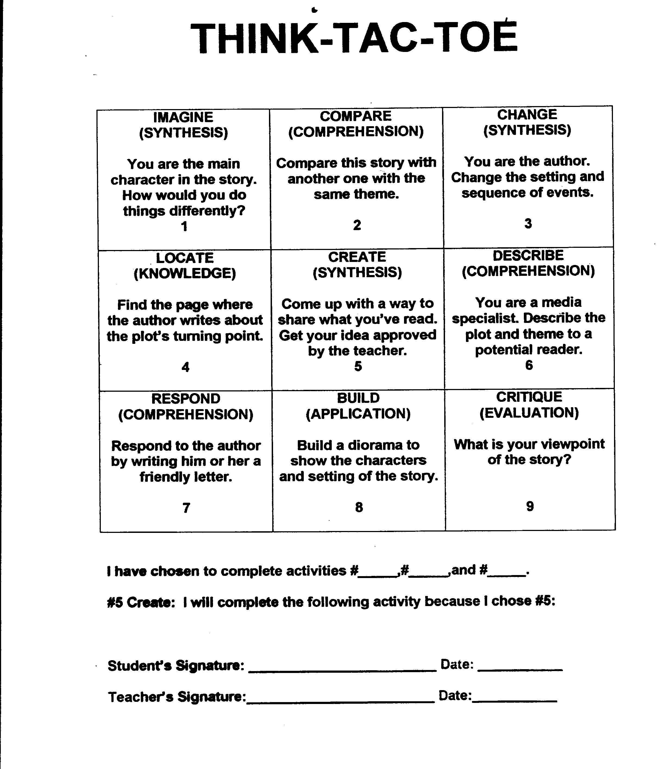

Slide 39
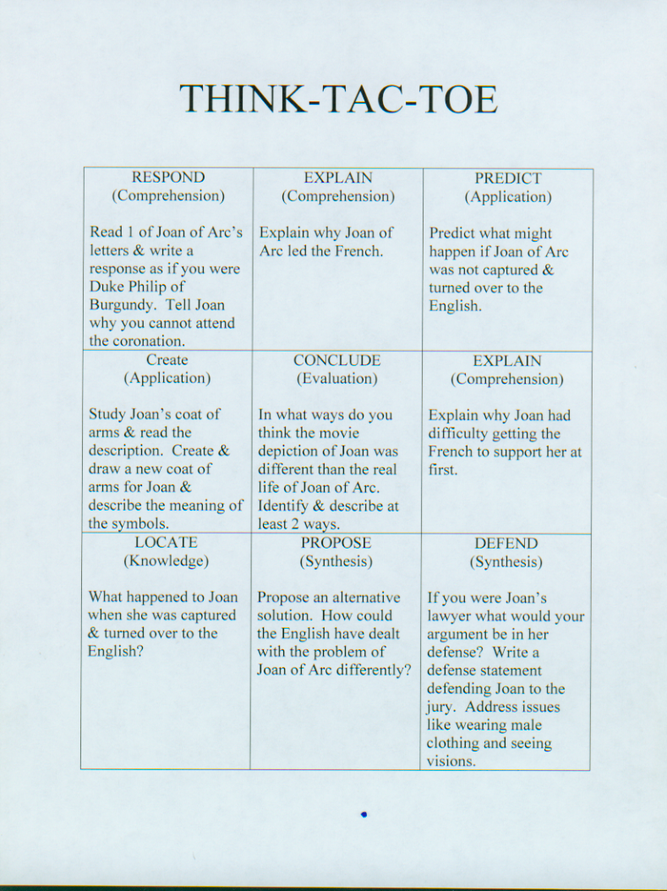

Slide 40
Biome Think-Tac-Toe
Compare and Contrast Use Inspiration in the Student Aps folder to create a graphic organizer that compares two biomes. If you do not have computer privileges create a Venn diagram on your own paper. | Written Document Analysis Analyze the provided primary source document using the Document Analysis Worksheet. | Read-a-Picture Use the provided questions to analyze a provided picture of one of the seven biomes.
Kinesthetic Testing Tactics Use the provided words to write sentences showing the relationships of the cards. Shuffle the cards and then lay them out in 3 rows of 3. You should write 8 sentences: 3 for the 3 rows going across, 3 for the 3 rows going down, and 2 for the diagonals. | A Wrinkle in Time Use the Timeliner software in the Student Aps folder to create a timeline of the seasons of one biome. | Walk a Mile in my Footsteps Create footprints to represent a biome. One footprint must contain written information while the other contains only pictorial representations.
Jeopardy using Power Point Use a Microsoft PowerPoint template to create a Jeopardy type game that reviews information on the biomes. | Create a Brochure Go to the website www.mybrochuremaker.com Create a travel brochure that includes information needed by people considering taking a vacation in one of the biomes. | Make Your Case Use a Microsoft Word template to create a CD Jewel Case Label related to a selected biome. Include a band name, song titles and production notes that relate to that biome.

Slide 41
RAFT WRITING ASSIGNMENTS
ROLE | AUDIENCE | FORMAT | TOPIC
Semicolon Lung Tree Young Chromosome | Middle School Student Owner Urban Sprawl Experienced Chromosome | Diary Entry Owner’s Guide Editorial Picture Book | I Wish You Really Understood Where I Belong Maximizing Product Life My Life is Worth Saving What Becomes of us in Mitosis

Slide 42
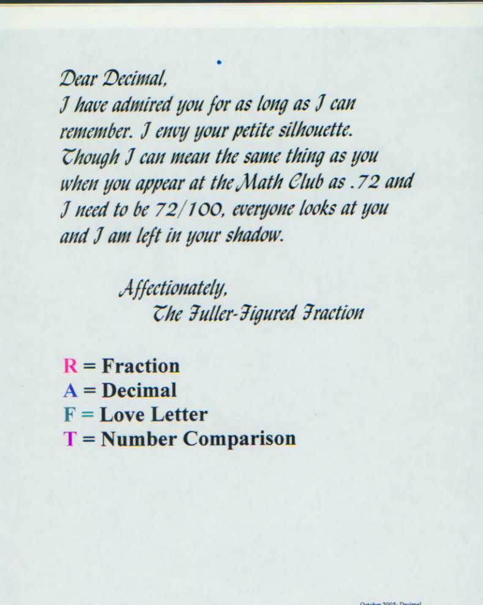

Slide 43
DIRECTIONS: PICK ONE OF THESE
ROLE | AUDIENCE | FORMAT | TOPIC
The Earth | Aliens who might want to live on Earth | A written set of rules with reasons | What you need to know and do if you want to live here
An endangered animal | Humans | A poster with an exhibit card to explain it | Why I need you and you can help save me
A natural resource | Our class | A speech | What people need to know about using us well

Slide 44
R.A.F.T.
THE GREAT DEPRESSION
ROLE | AUDIENCE | FORMAT | TOPIC
FDR | Public | Candidacy Speech | Hope for the Future
Unemployed Factory Worker | Friend | Letter | Looking for Work
St. Louis Post Dispatch | Public | Editorial | Causes/Effects of the Depression
Woman | Self | Diary Entry | Surviving during Depression

Slide 45
Pre-Algebra RAFT
ROLE | AUDIENCE | FORMAT | TOPIC
Coefficient | Variable | E-mail | We belong together
Balance | Students | Advice Column | Keep me in mind when solving problems
Variable | Humans | Monologue | All that I can be
Variable | Algebra students | Instruction Manual | How and why to isolate me
Algebra | Public | Passionate plea | Why you really need me

Slide 46
Role | Audience | Format | Topic
Chemist | Chemical company | Instructions | Combinations to avoid
Wheat Thin | Other Wheat Thins | Travel Guide | Journey through the digestive system
Plant | Sun | Thank-you note | Sun's role in plant's growth
Zero | Whole numbers | Campaign speech | Importance of the number 0
Exponent | Jury | Instructions to the jury | Laws of exponents
Water drop | Other water drops | Travel guide | Journey through water cycle
Limestone rock | Cave visitors | Postcard | Chemical weathering process
Statue | Dear Abby readers | Advice column | Effect of acid rain
Bird | Wright Brothers | Complaint | New invention disrupts skies
21st Century Woman | Susan B. Anthony | Thank-you note | Women's Rights
Community helper | Community | Speech | Why you can't do without me
Notes:
46

